Slide 1

RATINGS PREDICTION PROJECT
Presented by:
Ashika yasmeen

Slide 2
PROBLEM STATEMENT
We have a client who has a website where people write different reviews for technical products. Now they are adding a new feature to their website i.e. The reviewer will have to add stars(rating) as well with the review. The rating is out 5 stars and it only has 5 options available 1 star, 2 stars, 3 stars, 4 stars, 5 stars. Now they want to predict ratings for the reviews which were written in the past and they don’t have a rating. So, we have to build an application which can predict the rating by seeing the review.
Rating prediction is a well-known recommendation task aiming to predict a user’s rating for those items which were not rated yet by her. Predictions are computed from users’ explicit feedback, i.e. their ratings provided on some items in the past. Another type of feedback are user reviews provided on items which implicitly express users’ opinions on items. Recent studies indicate that opinions inferred from users’ reviews on items are strong predictors of user’s implicit feedback or even ratings and thus, should be utilized in computation.

Slide 3
MACHINE LEARNING
Machine Learning is a subfield of Artificial Intelligence (AI) that works with algorithms and technologies.​
Machine Learning (ML) is categorized into two groups:​
Supervised ML: In supervised ML, we are given a dataset and already know our output, having the idea of relationship between input and output data. Supervised machine learning problems are categorized into regression and classification problems.​
Unsupervised ML: In Unsupervised ML, there is no information or idea about output is known i.e there is no relationship between input and output data. We can derive structure by clustering the data based on the relationships among the variables in the data.​
In this project, we used supervised machine learning to predict the customer retention in Indian E-commerce using classification models.​

Slide 4
EXPLORATORY DATA ANALYSIS
Data Visualization
Data Pre-Processing
Natural Language Processing
Lemmatization
Vectorization
Splitting the data into features and target
Building a model
Choosing the best model
Saving the model

Slide 5
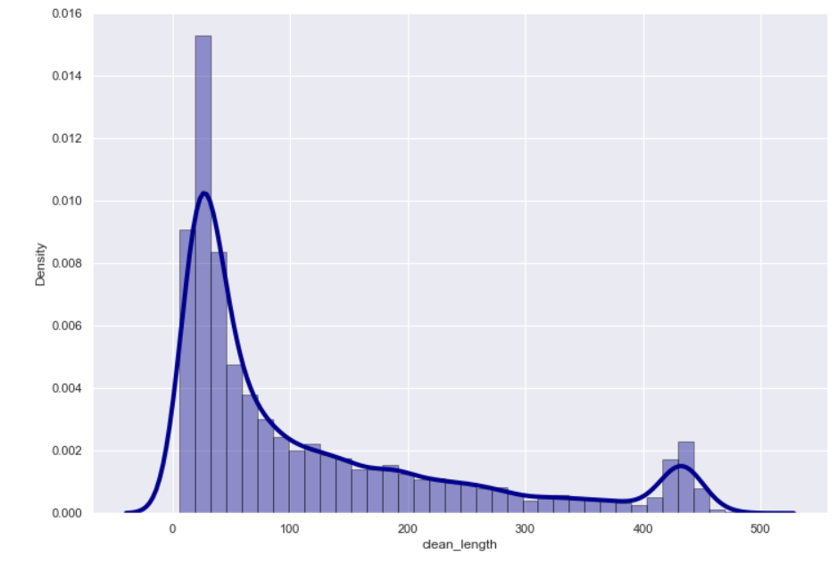
VISUALIZATIONS
Character Count

Slide 6
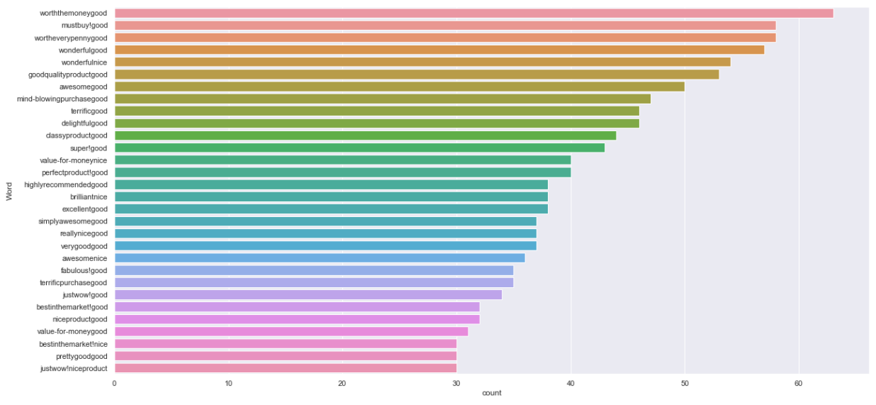
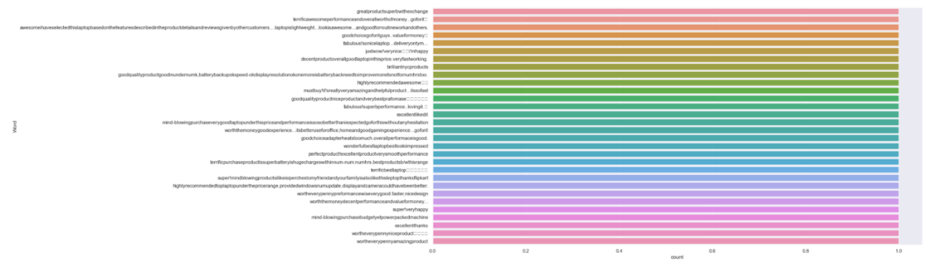
visualizations
Top 30 most frequently occurring and rarely occurring words.

Slide 7
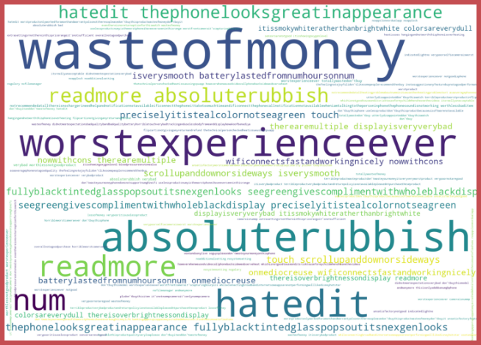
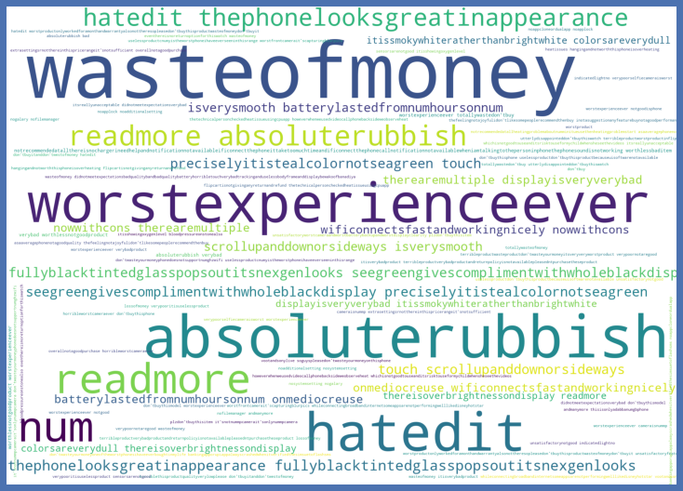
visualizations
WordCloud of rating1,2,3,4 and 5.

Slide 8
STEPS AND ASSUMPTIONS USED
Finding if the null values are present. There are no null values present in this dataset.
Correlation: Finding the correlation between the target and input columns.
Describe of dataset: This gives the mean, standard deviation, maximum and minimum value.
Skewness: Skewness has been checked using normal distribution curve and been removed using power transform method.
Natural Language Processing: All the uppercase letters are converted into lower case, punctuations, web address and email, phone numbers are replaced.
Lemmatization is done.
Vectorization is done to convert the text into machine readable form.
tf-idf (term frequency-inverse document frequency) method is used to vectorize text.
The dataset has been divided into features and vectors.
Data scaling is done using standard scaler.
Building the model using classification technique and the best model is saved.

Slide 9
MODEL DASHBOARD
Classification models are used to predict the comment toxicity in this project.
Logistic Regression: It gives the relationship between the dependent and independent variables. It is used when the value of the target variable is categorical in nature.
Decision Tree Classifier: It is a tree-structured classifier, where internal nodes represent the features of a dataset, branches represent the decision rules and each leaf node represents the outcome.
KNNeighbors Classifier: In KNN, K is the number of nearest neighbors. The number of neighbors is the core deciding factor.
Random Forest Classifier: It consists of many decision trees. It uses bagging and feature randomness when building each individual tree and try to create an uncorrelated forest of trees whose prediction by committee is more accurate than that of any individual tree.
Ada Boost Classifier: It is one of the ensemble boosting classifier that begins by fitting a classifier on the original dataset and then fits additional copies of the classifier on the same dataset.
Gradient Boosting Classifier: This classifiers combines many weak learning models together to create a strong predictive model.
XGBoost Classifier: It is an optimized Gradient Boosting technique.

Slide 10
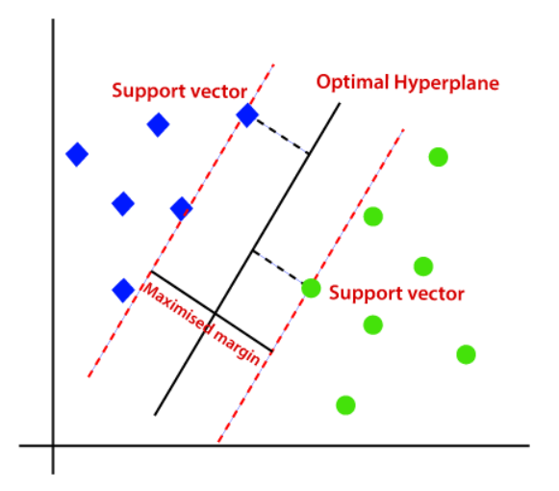
FINALIZED MODEL
Support Vector Classifier is chosen as a best model with 72% accuracy.

Slide 11
CONCLUSION
In this project report, we have used NLP machine learning algorithms to predict the Ratings. We have mentioned the step by step procedure to analyze the dataset and finding the correlation between the features.
Thus we can select the features which are correlated to each other and are independent in nature. The power of visualization has helped us in understanding the data by graphical representation it has made me to understand what data is trying to say.
Data cleaning is one of the most important steps to remove unrealistic values and unnecessary punctuatuions, urls, email address, stop words.
These feature set were then given as an input to 6 algorithms and a hyper parameter tunning was done to the best model. Hence we calculated the performance of each model using different performance metrics and compared them based on these metrics.
Then we have also saved the best model.

